Slide 1
Pulse Crops in School Meals
National School Lunch &
National School Breakfast Programs
Spring 2015
USADPLC and APA

Slide 2

How can pulse crops be used in school meals?
Vegetable
Meat Alternative
Either or
but not both in the same meal

Slide 3
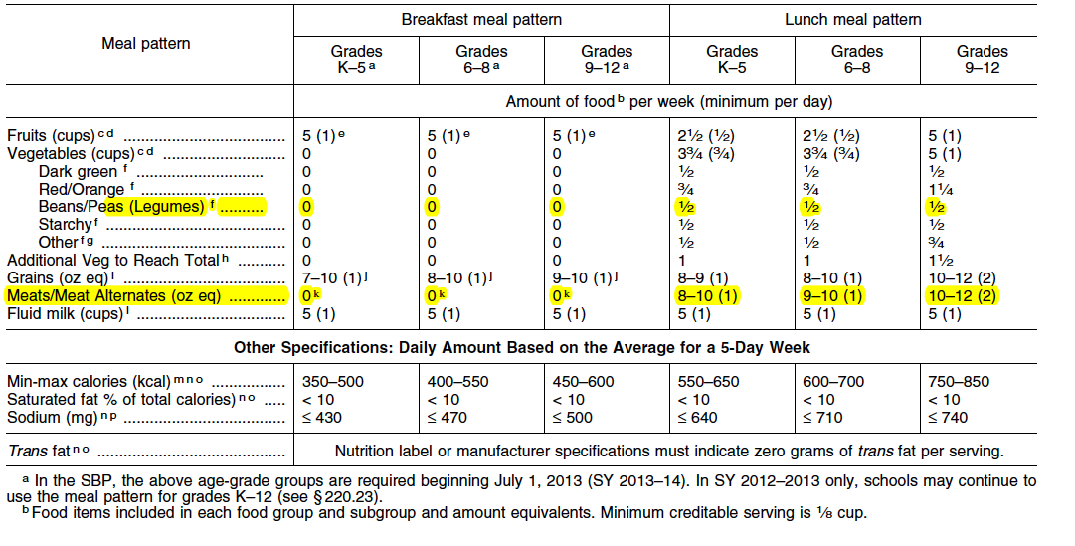
Healthy Hunger Free Kids Act 2010

Slide 4
Vegetable
Subcategory: “dry beans & peas” (legumes)
½ cup per week
  Minimum serving size=1/8 cup
  For example a school might serve:
  1/8 cup Monday
  1/4 cup Wednesday 1/2 cup total
  1/8 cup Friday

Slide 5
Vegetable: Smoothies
“ Vegetables from the dry beans and peas subgroup may credit toward the vegetable meal pattern requirement as juice when served in a smoothie”
    Volume is measured after pureed
“Commercially prepared smoothies may only credit toward the fruit or vegetable components.”
Protein powders and herbal supplements are not creditable for CNP
“Smoothies Offered in Child Nutrition Programs” Memo-USDA Food and Nutrition Service January 14, 2015

Slide 6
Meat Alternative
“Beans and peas (legumes) cooked dry beans and peas may be used to meet all or part of the meat/meat alternates component.”
1 oz-meat-equivalent = ¼ cup cooked beans
USDA Food Buying Guide for Child Nutrition Programs Section 1 Meat/Meat Alternates

Slide 7
Meat Alternatives: other options
Enriched Macaroni products with fortified protein
  7 CFR Part 210 Appendix A
Alternate Protein Products
  7 CFR Parts: 210, 215, 220, 225, 226

Slide 8
Enriched Macaroni with Fortified Protein
Must meet nutrient specifications
  PDCAAS
    Protein content is not less than 20% by weight
    95% that of casein
Must be approved by FNS ( Food & Nutrition Services- USDA)

Slide 9
Enriched Macaroni with Fortified Protein
“One ounce (28.35 grams) dry weight of this product meets one-half of the meat or meat alternate requirements of lunch or supper of the USDA child nutrition programs when served in combination with 1 or more ounces (28.35 grams) of cooked meat, poultry, fish, or cheese. “

Slide 10
Alternate Protein Products
Product: “processed so that some portion of the nonprotein constituents of the food is removed “ Not Whole
Quality:
  “least 80 percent that of casein, determined
by performing a Protein Digestibility Corrected
Amino Acid Score (PDCAAS).”
  must contain at least 18 percent protein by weight
when fully hydrated or formulated “
“provide documentation that the product meets the criteria”
7CFR Ch. II ( 1-1-03 Edition) Part 226.27 Appendix A to Part 226- Alternate Foods for Meals

Slide 11
APP: How used?
May be used alone or in combination with other food ingredients. Examples of combination items are beef patties, beef crumbles, pizza topping, meat loaf, meat sauce, taco filling, burritos, and tuna salad.
Alternate protein products forms:
  Dry (nonhydrated),
  partially hydrated or
  fully hydrated
7CFR Part § 210.10. & Questions and Answers on Alternate Protein Products

Slide 12
Opportunities
Vegetable
Meat alternative
  Whole or pureed in smoothie
  Whole
    Recipe
    Food product
  Enriched macaroni product
  APP

Slide 13
Child Nutrition Label
A CN labeled nonmeat product:
must contain a minimum of 0.50 ounce of equivalent meat alternate per serving,
may contain cheese/cheese substitutes, cooked dry beans or peas, eggs, nut/seed butters, alternate protein product, protein fortified macaroni, or any combination of these, and
must be produced under Federal inspection.
Products contributing only to the bread/bread alternate and/or vegetable/fruit components are not eligible for the CN label.
USDA: “Child Nutrition Labeling for Nonmeat Products”

Slide 14
Next steps
Do you have a product that might be considered an enriched macaroni product or alternate protein product?
  ✔ Reference nutrition requirements in 7 CFR 210, 215, 220, 225, 226
✔ Conduct Nutrient & Protein Analysis of product
  FNS Technical Assistance Section (703) 305-2609 ask for CN Label
  reviewer
  ✔ Enriched Macaroni- seek FNS approval
  ✔ Apply for CN on relevant product ( see USDA CN Label report)

Slide 15
Resources & References
  USDA Food & Nutrition Services
7 CFR Parts 210 and 220 Nutrition Standards in the National School Lunch and School Breakfast Programs; Final Rule ( Healthy Hunger Free Kids Act
USDA: Child Nutrition Labeling for Nonmeat Products
7CFR Ch. II ( 1-1-03 Edition) Part 226.27 Appendix A to Part 226- Alternate Foods for Meals
Food Buying Guide for Child Nutrition Programs Section 1:Meat/Meat Alternates
Lunch School Meal Pattern Instructor’s Manual- National Food Service Management Institute The University of Mississippi
School Meals USDA Policy Memos can be found at http://www.fns.usda.gov/cnd/governance/policy.htm

Slide 16
USA Dry Pea & Lentil Council
American Pulse Association
Jessie Hunter, MPH, RDN
Director of Research
208-882-3023
jhunter@pea-lentil.com
hunter@americanpulsecrops.org

